Slide 1



Slide 2
CONTENTS:
Description
Business Objective
High Level Functionality
Architecture/Application
Technical Details
How it is integrated with other systems
Application link and user details
Appendix

Slide 3

DESCRIPTION:
In order to gain the loyalty of the customers TESCO had launched Clubcard in the year 1994.
All the Clubcard holders are sent coupons based on their shopping habits, life stage, life style, geographic location.
Coupons are thus highly targeted based on the above mentioned range of attributes.
TEPLOG is the file generated by the stores which has the record of everything that the customer is buying and this file is ultimately sent to DHA(Dunn Humby Associates) for analysis of customer buying habits. Based on this, coupons are sent to customers.
There are various types of coupons which satisfy the objectives of the Clubcard.
Some examples of coupons are bonus coupons, price promise coupons

Slide 4
CONTD:
->Price promise facility is there for customers having active coupons. Price promise means if a customer for example buys tea from a TESCO store @ £20 and another TESCO competitor store sells tea @ £18 then the customer can claim that extra money he invested in TESCO store. TESCO in turn does a market survey and ensures whether the information was true. If yes then it issues coupons worth of that value and gives it to that customer.
->Once the customer uses his/her coupon then the coupon is given a status i.e. used.
->Once the coupon is spoilt then it is given a status i.e. cancelled.
-> Unlike vouchers, coupons cannot be reissued.

Slide 5
BUSINESS OBJECTIVE:
Objectives of Clubcard Coupons are as follows:
Drive Trade
Encourage repeat purchase
Increase depth and
breadth of spend
Retain Customers
Reactivate lapsed customers

Slide 6
CONTD:
Drive Trade:
* Clubcard statement coupons are individually targeted.
* TESCO issues 84 million within each statement.
* A minimum of 30% of customers are rewarded “thank you” with 70% acquisition.
* These can be funded by suppliers or Tesco Commercial or Clubcard or jointly funded.
* Overall redemption is 25%
* Each statement TESCO generates is up to £50m in sales uplift from coupons.
Retain Customers:
*A coupon for extra points on a product that a customer already buys helps in retaining customers.
*Statement coupons are the 2nd best valued among all other TESCO communications by customers. Statement vouchers are in the 1st place.

Slide 7
CONTD:
Encourage repeat purchase:
*Coupons which have discounts on the products that the customer is willing to buy make them come back again in TESCO stores.e.g if a customer opts for baby toddler preference in his my Clubcard account (MCA) he/she will get coupons on baby products. This will make them shop again and again.
Reactivate lapsed customers:
*A gift coupon and a questionnaire to a customer who has stopped shopping helps in reactivating lapsed customers.
Increase depth and breadth of spend:
*If we give corn flakes coupons for healthy living club members who haven’t yet opted for it will surely increase the breadth of spend.
*If customers are given coupons on the products which they buy often will again increase the depth of spend.

Slide 8
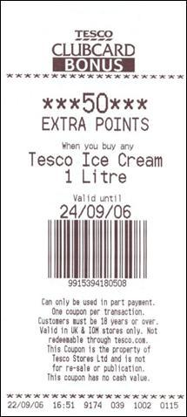
CONTD:
Increase depth and breadth of spend(contd):
Clubcard Bonus is a targeted coupon printed at the till.
Up to 8m customers may be targeted at any one time to
receive a coupon.
Example coupons:
  Discounts on products you like to buy.
  National trade driving promotions.
  e.g. 5p off a litre of petrol.
  Conditional spends to encourage repeat visits
  It’s a useful tool for contacting customers
  that we cannot mail.
  Giving customers more choices and flexibility increases
  depth and breadth of spend.

Slide 9
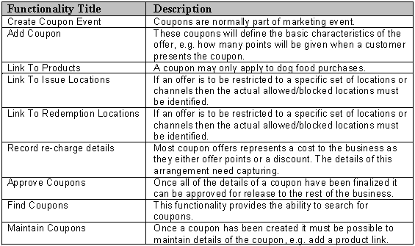
HIGH LEVEL FUNCTIONALITY:

Slide 10
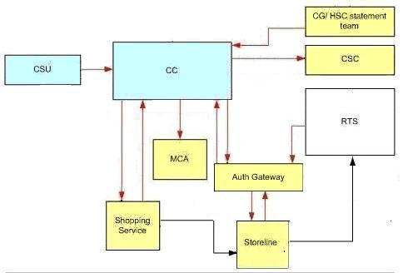
ARCHITECTURE DIAGRAM:
1.CLUBCARD COUPON INTERFACES DIAGRAM:

Slide 11
CONTD:
1.ACCORDING TO THE INTERFACE DIAGRAM FOLLOWING ARE THE INFORMATION:
Interfaces | Description
Coupon Setup | CSU will provide a central repository for all Coupon information. Users will be able to upload the signed off Coupon information into the system
Clubcard Coupons | Clubcard Coupons will deliver a secure, flexible and multi-channel solution for coupons
CG/HSC Statement Team | CG/HSC Statement team will provide smart barcodes and pass on the alphanumeric codes to print on individual smart coupons, and will provide the information to the Clubcard Coupons system
CSC | Customer service centre to resolve any query about Clubcard coupons
MCA | My Clubcard Account – existing public website that enable customers to view details of their Clubcard account such as vouchers and coupons they’ve been awarded
Shopping Service | The dotcom website services that handles the sale of Grocery
Store line | In-store tills
RTS | Real Time Sales. An existing system which receives basket level data from all transaction processed by Store line
NGC | Next Generation Clubcard

Slide 12
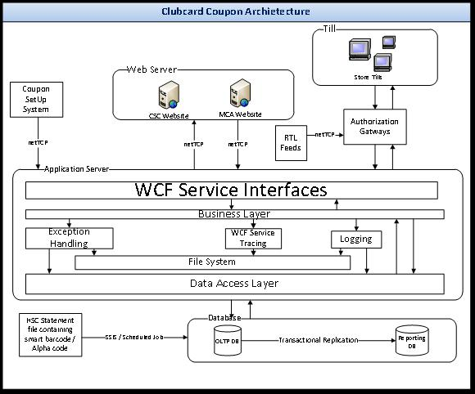
2.CLUBCARD COUPON SYSTEM ARCHITECTURE DIAGRAM:
CONTD:

Slide 13
TECHNICAL DETAILS:
This section provides an overview of how the Clubcard Coupons system will be structured.
A new database system “Clubcard Coupons” is there which receives coupon information, customer allocation, smart barcodes and alphanumeric codes, and serves as a strategic central system for multi-channel and smart coupon information as well as lookup for My Clubcard Account to display customer coupons.
For coupon redemption, the system will also expose various real time interfaces (web services) which can be called upon by in-store Tills and dotcom checkout (when developed) to check if the coupon has already been redeemed.
The solution will use another system, Coupon Setup (CSU), to correlate the Coupon information from various sources and will pass the information to Clubcard Coupons system.

Slide 14
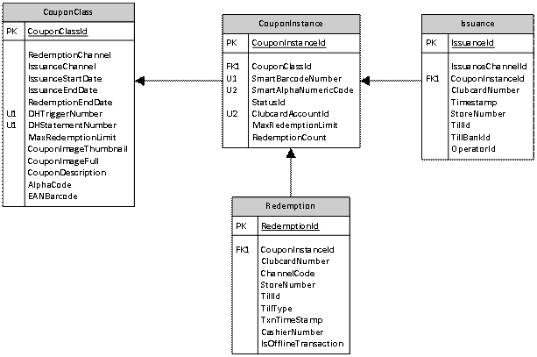
CONTD:
For maintaining the details of all the coupons there is a coupon system. Mainly there are 4 important tables as follows:

Slide 15
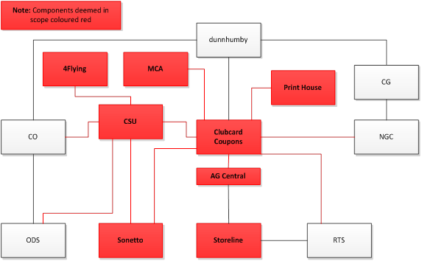
HOW IT IS INTEGRATED WITH OTHER SYSTEMS:

Slide 16
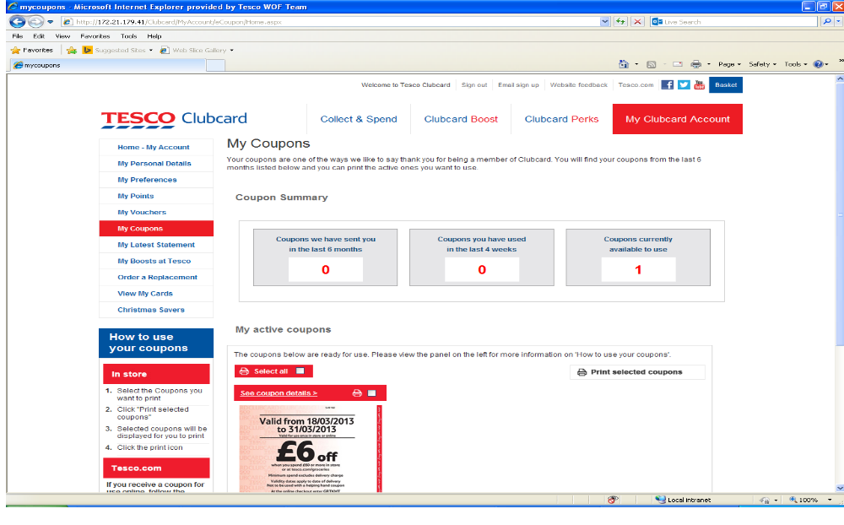
APPLICATION LINK AND USER DETAILS:
On My Clubcard Account Page the customer can view ‘My Coupons’ page. Below is the link:
http://172.21.179.41/Clubcard/MyAccount/eCoupon/Home.aspx
The screenshot of ‘my coupons’ page is as follows:

Slide 17
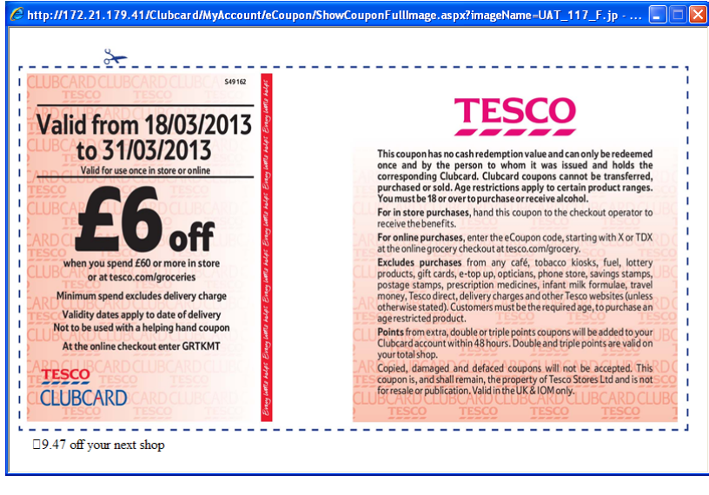
CONTD:
The customer can use their coupons
In two ways:
1)In store - Select the Coupons you want to print
Click "Print selected coupons"
Selected coupons will be displayed for you to print
Click the print icon
2)Online - If you receive a coupon for use online, follow the steps below:
Copy the online eCode found below the coupon image
Paste or enter the code at the Tesco.com checkout

Slide 18

APPENDIX:
Hub Link:
http://team.hub.tesco.org/HeadOfficeandCommercialIT/clubcardmarketingIT/Coupons_Vouchers/International%20Smartvouchers/Forms/AllItems.aspx

Slide 19
THANK YOU

